Slide 1
PlasmaGraph Presentation
Mid-Project Progress Presentation
(SRS, SPMP, and Prototype Presentation)
Gerardo A. Navas Morales (ID: 69615)
Daniel Quintini (ID: 73249)

Slide 2
Presentation Organization
PlasmaGraph?
Design Decisions / How Will it Be Made?
Current Status
Conclusion

Slide 3
PlasmaGraph Context
PUPR Plasma Laboratory produces lots of data. (Some is good, some is not good.)
Data needs to be graphed relatively quickly.
Data needs to be verified before used.
Graphs need to be saved.
Multiple computers in the lab.

Slide 4
Solution
A portable, flexible graphing program which can import data, and can save images and settings; named "PlasmaGraph".

Slide 5
Design Decisions
Portability: Java. ("Build once, run anywhere.")
Flexible: Templates. (Create a group of settings, save, and reuse and edit whenever.)
Graphing: Java's "JFreeChart" library. (Set of tools that create flexible and powerful graphs.)
Importing Data: Java's "OpenCSV" library and powerful native file-reading tools. (Java's basic libraries, combined with OpenCSV's additional tools. Will open CSV files, read them, and create data sets however is necessary.)

Slide 6
Design Decisions (Continuation)
Save Images: Java's "JFreeChart" library. (Again, it provides the tools to save graphs in both JPG and PNG formats.)
Save Settings: Java's powerful file-writing tools. (Java's libraries are extensive and flexible.)

Slide 7
Design Decisions (Continuation)
<swot_lenguajes>

Slide 8
Design Decisions (Continuation)
<swot_graphing_tools>

Slide 9
How Will It Be Made?
Two people.
Gerardo A. Navas Morales
Daniel Quintini
One Supervisor
PUPR Professor Luis A. Ortiz
One Client
PUPR Professor Angel Gonzales
Java IDE tools: Eclipse, NetBeans IDE

Slide 10
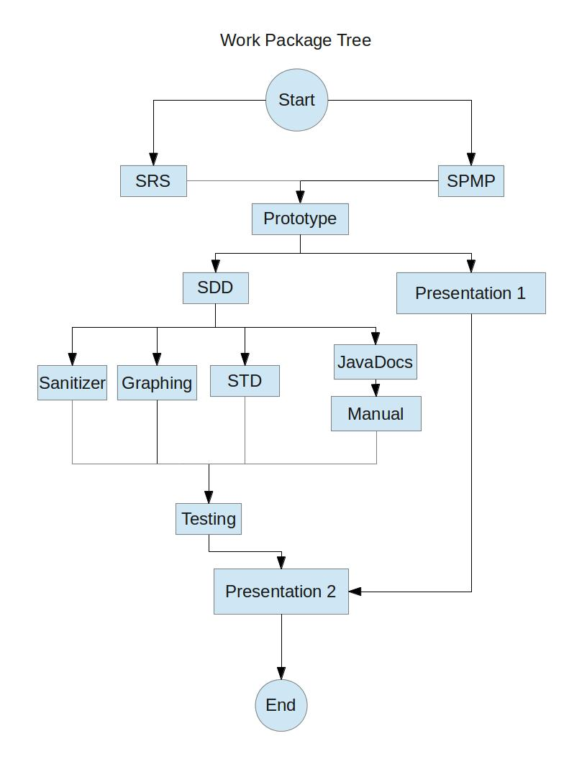
Project Work Order

Slide 11
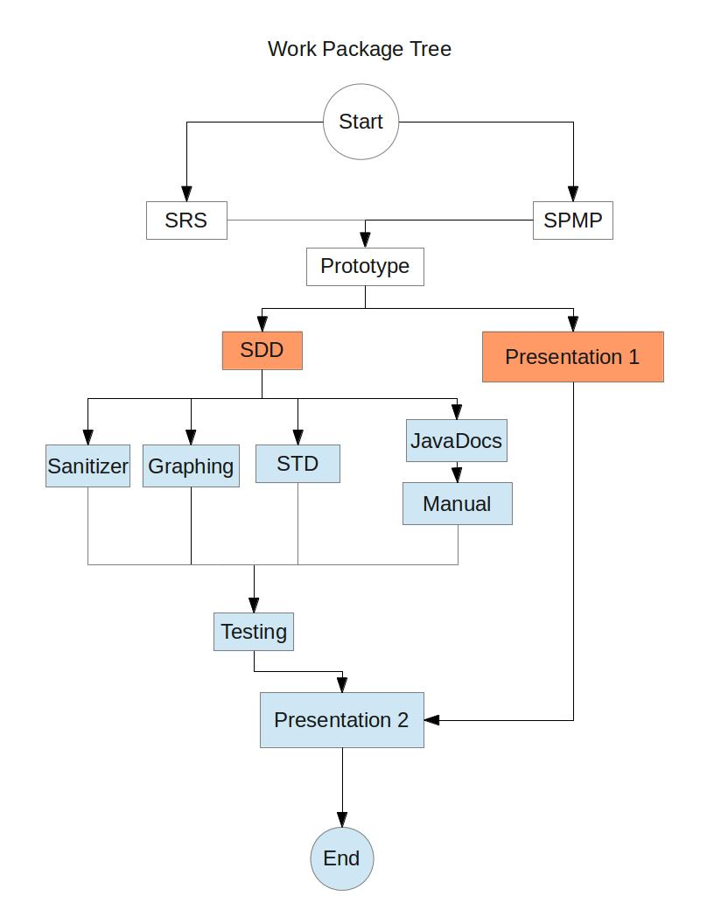
Project Progress

Slide 12
Current Status (Continuation)
First drafts of the SRS and SPMP are completed and being revised.
SDD is being worked on.
Prototype is finalized.
STD's tests are being drafted up based on experience making Prototype.

Slide 13
Remaining Work
SDD (Software Design Documents) and STD (Software Test Documents)
STD's tests are being drafted up based on experience making Prototype.
Final product hasn't been started on.
The final Presentation, and all necessary deliverable packages, will be organized, and the project group will conclude operations.

Slide 14
Conclusion
PlasmaGraph is, in its core, a graphing system tailored for the tasks that the PUPR Plasma Lab requires.
The project group is about halfway through development of all required products.
Project is estimated to be completed before the end of PUPR's Winter 2013 (WI-13) trimester.

Slide 15
Questions?

